Slide 1
Learning Big Data
Aditya Konda
Big Data Engineer

Slide 2

Content
CAP Theorem
NoSQL Database
Cassandra
Introduction
Cluster
Feature
Column family

Slide 3


NoSQL Database
Are also know as Not Only SQL
No fixed schema
Primary objectives of a NoSQL are
Simplicity of design
Horizontally scalable
Fine control over avaiblity

Slide 4
Cassandra
Created by Facebook
Master-less design architecture
No single point of failure
Highly scalable
Column-oriented database
Scalable, fault-tolerant, and consistent

Slide 5
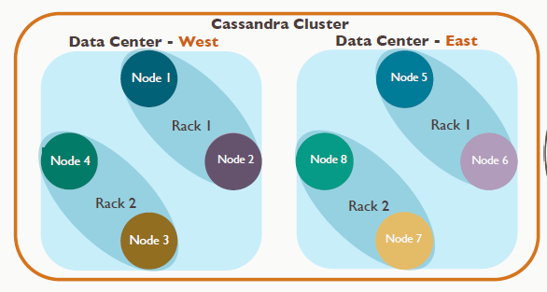
Cassandra Cluster

Slide 6
Cassandra – Features
Elastic Scalability
Always on architecture
Easy data distribution
Transaction support
Flexible data storage
Fast write

Slide 7
Cassandra
All the nodes in a cluster play the same role.
Each node in a cluster can accept read and write requests
When a node goes down, read/write requests can be served from other nodes in the network
one or more of the nodes in a cluster act as replicas
return the most recent value to the client
performs a read repair in the background to update the stale values.
Gossip Protocol allow the nodes to communicate with each other and detect any faulty nodes

Slide 8
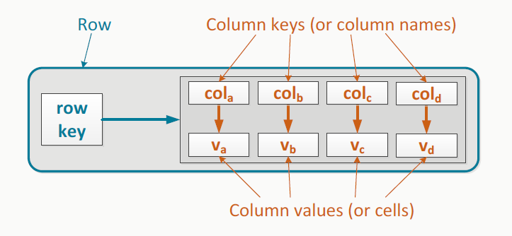
Column Family

Slide 9
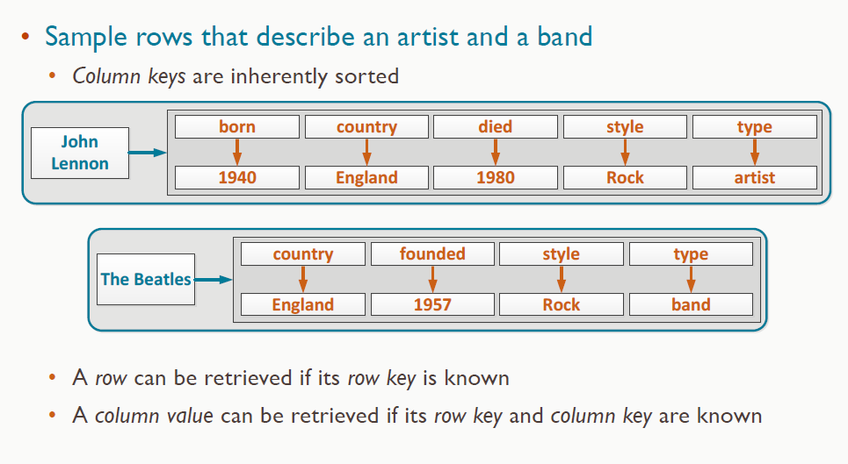
Column Family
Skinny row
Wide row
Example : row that stores all band of the same style

Slide 10
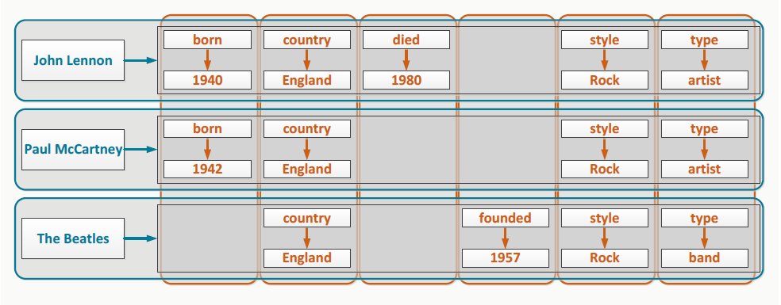
Column Family
Column family that stores data about artist and bands

Slide 11
Cassandra Query Language
access Cassandra through its nodes using Cassandra Query Language (CQL)
Keyspace: CQL treats as a database.
cqlsh: a prompt to work with CQL
Operations on Cassandra
Write operations
Read operations

Slide 12
Cassandra Components
Commit log − The commit log is a crash-recovery mechanism in Cassandra. Every write operation is written to the commit log.
Mem-table − A mem-table is a memory-resident data structure. After commit log, the data will be written to the mem-table.
SSTable − It is a disk file to which the data is flushed from the mem-table when its contents reach a threshold value.
Bloom filter − These are nothing but quick, nondeterministic, algorithms for testing whether an element is a member of a set. It is a special kind of cache. Bloom filters are accessed after every query.

Slide 13
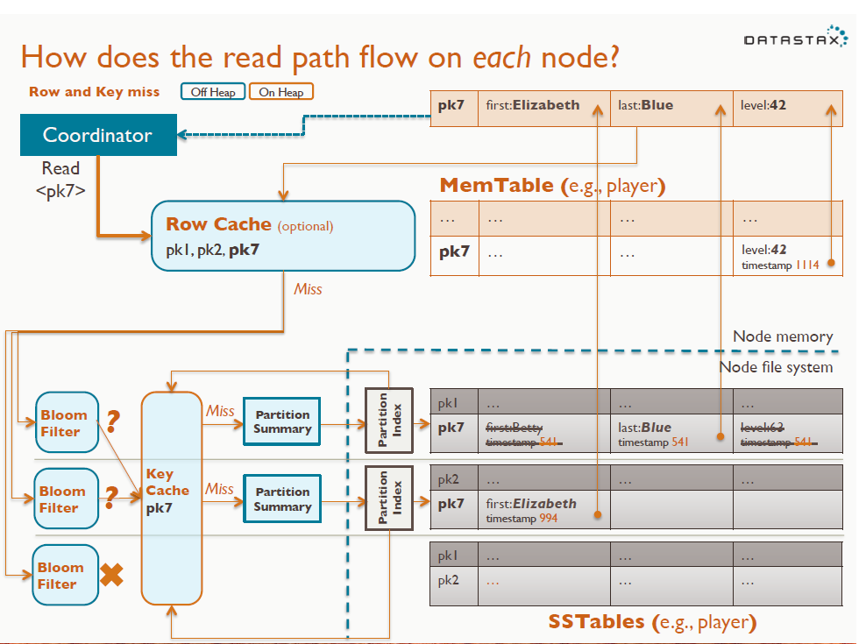
Cassandra Write Path

Slide 14
CAP Theorem
Choosing a right database is very essential for an organization.
Consistency: every read would get you the most recent write
Availability: every node (if not failed) always executes queries
Partition-tolerance: even if the connections between nodes are down, the other two (A & C) promises, are kept
A distributed system can satisfy any two of these guarantees at the same time but not all three

Slide 15
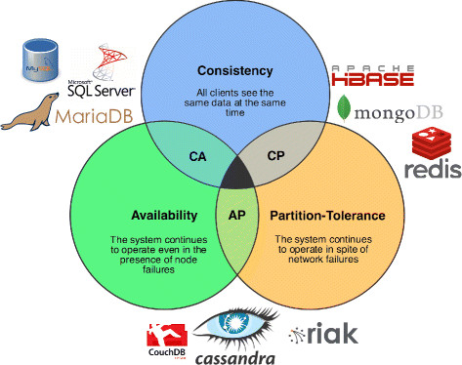
CAP Theorem

Slide 16
CAP Theorem
A simple proof using two nodes:
A
B

Slide 17
CAP Theorem
A simple proof using two nodes:
Not Consistent!
A
B
Respond to client

Slide 18

CAP Theorem
A simple proof using two nodes:
Not Available!
A
B
Wait to be updated

Slide 19
References
CAP Theorem
Cassandra brief introduction
NoSQL Database
Cassandra tutorial

Slide 20


